Slide 1

    COMMUNICATION AND MANAGEMENT
    SKILLS PROGRAMME
    FOR
    KALUTARA DISTRICT MEDICAL OFFICERS

Slide 2
History of Communication and Management skills programme
1ST Programme
Post intern medical officers at Ananda Kularatna Hall
2 day programme
On 15th and 16th of February 2014
450 participated for the post intern programme

Slide 3

DATE
28TH AND 29TH OF MARCH 2014
TIME
8.00AM TO 4.00PM
VENUE
NATIONAL INSTITUTE OF HEALTH SCIENCES (NIHS) KALUTARA

Slide 4
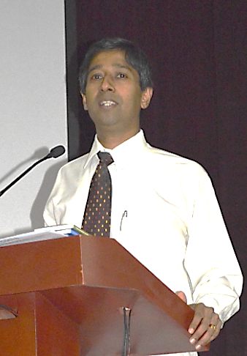
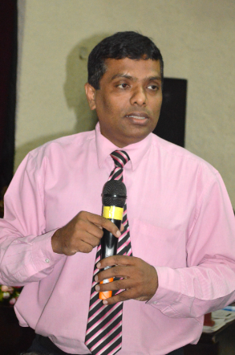
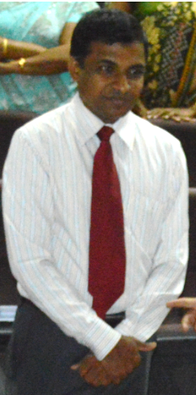
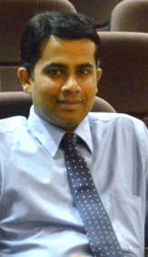
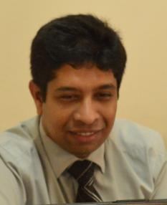
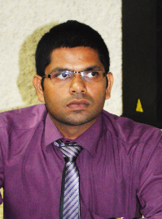
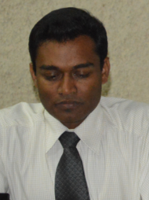

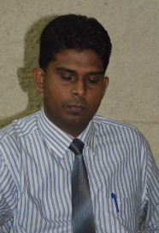
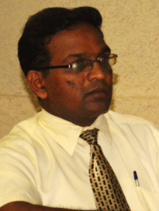
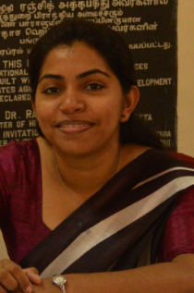
ORGANIZING COMMITTEE
Dr Anurudhdha Padeniya
Dr Ruwan Ferdinando
Dr Saman Abeywardana
Dr Lasantha Jinadasa
Dr Dineshan Ranasinghe
Dr Janaka Amarasinghe
Dr Janaka Marasinghe
Dr Chandana Dharmarathne
Dr Sampath Ratnaweera
Dr Kapila Siriwardana
Dr Mekhala Fernando

Slide 5
CHAIR PERSONS
Name | Designation
Dr Dilantha Dharmagunawardene | Acting Deputy Director ET & R
Dr Udaya Ratnayake | RDHS Kalutara
Dr Damith Silva | Exco GMOA
Dr Padmal Desilva | CCP-NIHS
Dr Chandana Dharmarathne | Secretary BU Panadura
Dr Indrani Malwanne | CCP-NIHS
DrJanakaAmarasinghe | Secretary BU Horana
Dr Sapumal Dhanapala | CCP -NIHS
Dr Sampath Ranaweera | Secretary BU Kalutara
Dr Janaka Marasinghe | Secretary BU Kalutara
DrKapila Siriwardana | Secretary NIHS

Slide 6
RESOURCE PERSONS
Dr A .Padeniya | Dr Buddhika Mahesh | Dr S. Hewage
Dr A.Sandanayake | Dr S. Wijesekara | Dr L.S Perera | Dr F.R. Niyas | Dr N.Peiris
Dr.N.M.Priyankara
Dr Upul Indunil Perera | Dr Gayani Imbulana | Dr Ruchith Priyantha
Dr K..Muthukumarana
Dr D. Ranasinghe | Dr L.Jinadasa | Dr S. Kannangara
Dr C.Gunathilake | Dr P . Gamage | Dr S.Warnasuriya
Dr Ruwan Ferdinando | Dr T. Kahaduwa
Dr L.T. Gamlath | Mr R Edussuriya

Slide 7
INNAUGARATION PROGRAMME
PROGRAMME
8.20AM Registration
8.25 AM Lighting of oil lamp
8.30AM National Anthem
8.35AM Welcome speech by Deputy Director Training NIHS
Dr Ruwan Ferdinando
8.40 AM Speech by RDHS Kalutara
Dr Udaya Rathnayake
8.45AM Speech by President GMOA
Dr. Anurudhdha Padeniya
8.50AM Speech by Deputy Director ET& R
Dr. DIlantha Dharmagunawardana
8.55AM Vote of thanks byConsultant Community Physician NIHS
Dr. Padmal De Silva

Slide 8
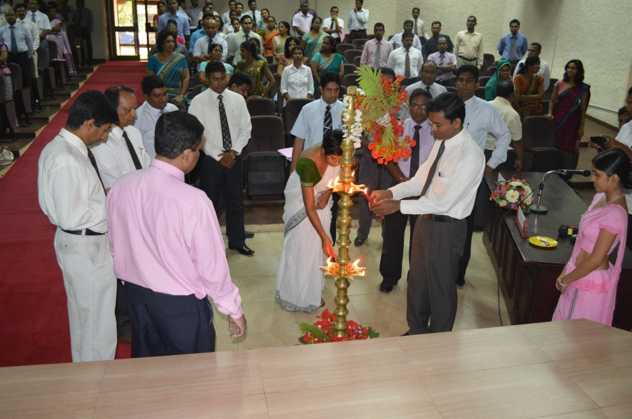
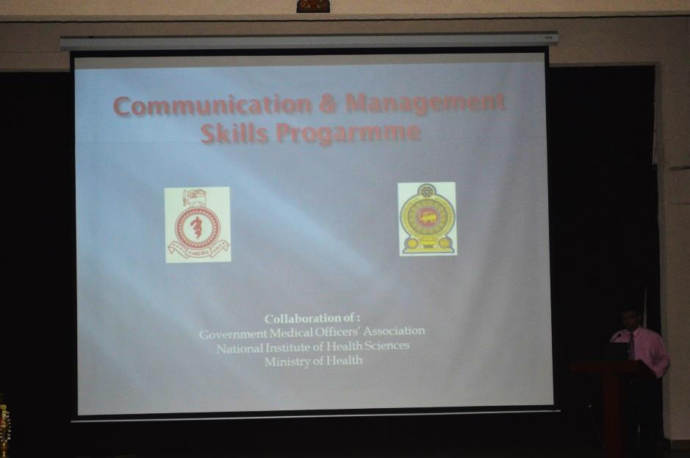
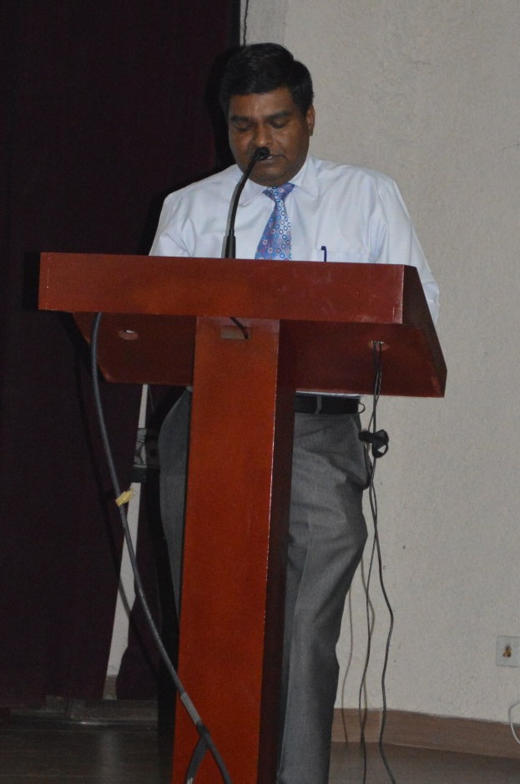
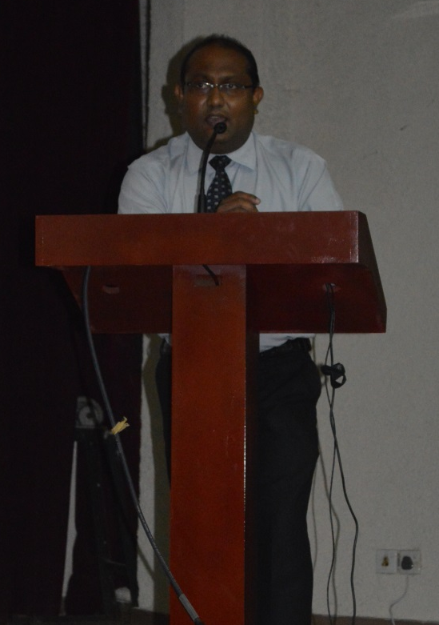
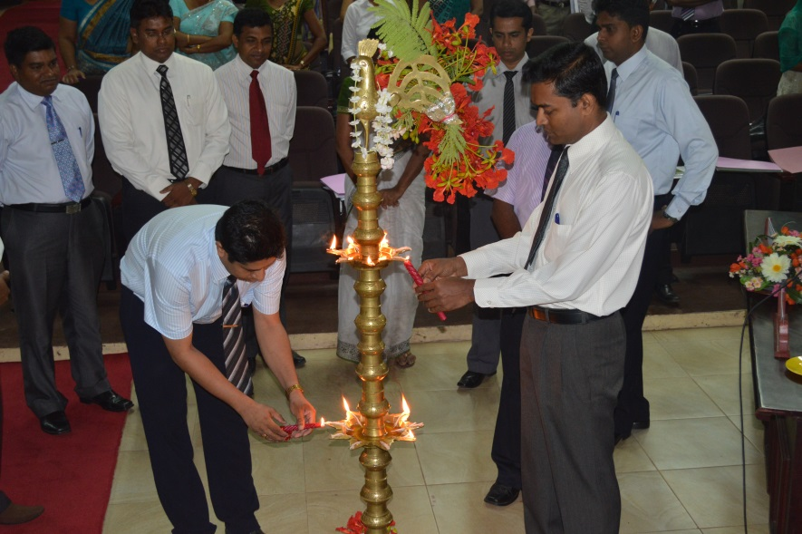
PHOTOGRAPHS OF THE
INNAUGARATION CEREMONY

Slide 9
PROGRAMME DAY 01
Day - 01 (27/03/2014) Time - 9.00am – 10.15 am Symposium No.- 01
Name of symposium | Time | Symposia | Chair Person | Speaker
Communication Skills for Medical Officers | 9.00-9.20am | Introduction to communication skills | Dr Dilantha Dharmagunawardana (acting DD ET &R) Dr Udaya Rathnayake (RDHS Kalutara) | Dr A .Padeniya
 | 9.20-9.40am | Introduction to essential skills of communication |  | Dr B. Mahesh
 |  |  |  | Dr S. Hewage
 | 9.40-10.00am | Demonstration of essential skills of communication
 | 10.00-10.15am | Participants’ views and Discussion
) Time - 10.45am – 12.00pm Symposium No.- 02
Name of symposium | Time | Symposia | Chair Person | Speaker
Public Relations | 10.45-11.05am | Introduction to public relations | Dr Udaya Rathnayake (RDHS Kalutara) Dr Damith Silva (Exco GMOA) | Dr A.Sandanayake (r S. Wijesekara
 | 11.05-11.25am | Qualities and skills for good public relations |  | Dr L.S Perera (
 | 11.25-11.45am | Public relations and You |  | Dr F.R. Niyas
 | 11.45-12.00nn | I believe I can fly |  | Dr N.Peiris
Time - 12.00pm - 1.15pm Symposium No.- 03
Name of symposium | Time | Symposia | Chair Person | Speaker
Mental Wellbeing of the communicator | 12.00-12.20pm | Emotional Intelligence | Dr RUwan Ferdinando (Deputy Director Training NIHS) Dr Chandana Dharmarthne (Secretary BU Panadura) | Dr Upul Indunil Perera
 | 12.20-12.40pm | Stress Management |  | Dr Gayani Imbulana
 | 12.40-.1.00.pm | Demonstration
 | 1.00-1.15pm | Participants’ views and Discussion
2.00-2.30pm Gender based attributes (Dr.N.M.Priyankara - Regional Epidemiologist, Badulla)- Chair person- Dr. Padmal de Silva
Time - 2.30pm – 3.45pm Symposium No.- 04
Name of symposium | Time | Symposia | Chair Person | Speaker
Team work and leadership | 2.30-250pm | Concept of team work in healthcare | Dr Indrani Malwanne (Consultant community physician) Dr Janaka Marasinghe (Secretary PU Kalutara) | Dr K..Muthukumarana
 | 2.50-3.30pm | Roles of a doctor in Teamwork
 | 3.30-3.45pm | Video presentation
 | 3.30-3.45pm | Discussion

Slide 10
PROGRAMME DAY 02
Day - 02 (28/03/2014) Time - 8.30am – 9.45am Symposium No.- 05
Name of symposium | Time | Symposia | Chair Person | Speaker
Breaking bad news | 8.30-8.50am | Bad news in health Care | Dr. Ruwan Ferdinando Deputy Director (Training), National Institute of Health Sciences Dr Sampath Ranaweera (Secretary GH Kalutara) | Dr D. Ranasinghe
 | 8.50-9.10am | How to break bad news effectively |  | Dr L.Jinadasa
 | 9.10-9.30am | Demonstration |  | Dr Sarada Kannangara
 | 9.30-9.45am | Participants’ views and Discussion
Time - 9.45am – 11.00am Symposium No.- 06
Name of symposium | Time | Symposia | Chair Person | Speaker
Active Listening | 9.45-10.05am | Importance of Listening skills for a doctor | Dr Lasantha Jinadasa (Asst Sec GMOA) Dr Janaka Amarasinghe (Secretary BU Horana) | Dr C.Gunathilake
 | 10.05-10.25am | Techniques of Listening |  | Dr S.Warnasuriya
 | 10.25-10.45am | Video presentation |  | Dr P.Gamage
 | 10.45-11.00am | Participants’ views and Discussion
11.30pm -12.15pm Counselling - Dr Ruwan Ferdinando
Time - - 12.15pm-1.00pm Symposium No.- 07
Name of symposium | Time | Symposia | Chair Person | Speaker
Public communication | 12.15-12.30pm | Principles of Public Communication | Dr Pradeep Wijesinghe (Director GH Kalutara) Dr. Kapila Siriwardena (Sec BU NIHS) | Dr Ruwan Ferdinando
 | 12.30-12.45pm | Introduction to media and journalism |  | Dr T. Kahaduwa
 | 12.45-1.00pm | Participants’ views
Time - 3.00pm – 4.00pm Symposium No.- 08
Name of symposium | Time | Symposia | Chair Person | Speaker
Administrative Symposium | 3.00pm-3.20pm | Hospital Administration |  | Dr L.T. Gamlath
 | 3.20pm-3.40pm | Establishment Code |  | Mr R Edussuriya
 | 3.40pm-4.00pm | Financial Regulation |  | Mr R. Edussuriya

Slide 11
OUT COME
No of Participants Day 01 – 160 Day 02-150
Participants from
Total budget for the programme – Rs 701,000
General Hospital Kalutara | Kalutara District Regional Hospital | Horana Base Hospital | Panadura Base Hospital
NIHS Kalutara | Colombo District Regional Hospital | Galle District Regional Hospital | General Hospital Vavunia
Base Hospital Mawanella | Teaching Hospital Jaffna | BH Tangalle | Castle Street Hospital for Women
General hospital Chilaw | Desoyza Hospital for Women | Lady Ridge way hospital | Teaching hospital Peradeniya
Cancer Institute Maharagama | Base Hospital Karawanella

Slide 12
TASK LIST
Issues | Serial No | Task | Background | Plan | Responsibility
Auditorium | 1 | Hall reservation | 200 hall |  | Dr Kapila ,Dr Ferdinando
 |  |  |  |  | Dr Kapila and NIHS team
Before and during the function | 2 | Sounds of the auditorium | Need 2 FM mics and 2 clip on mics 1 multimedia and 1 computer
 | 3 | Multimedia for the auditorium
 | 4 | Microphones and Podium arrangements
 | 5 | Computer to the podium and backup computer |  |  | Geeshan (GMOA)
2 Financial budget | 6 | Prepare the budget |  | Hand over to ET and R To Dr Ruwan ferdinando TO Peripheral branch union TO kalutara | Dr DIneshan
*****************IMP | 7 | Budget funding | Need around Rs 3 lakhs from sponsors |  | Dr Marasinghe Dr Ferdinando Dr kapila
 | 7 | Quatatition for food /video presentation and travelling |  | Take a quotation and hand it over to Dr DIlantha | Dr Dineshan(GMOA)
3 Design Printing and Distribution of Invitations | 8 | Print invitations | Decided to print invitations on 15th of March | Invite Dr Sunil De Alvis | Dr Dineshan (GMOA)
 | 9 | Priniting of certificates of participants |  | Send final copy of sertificate to Dr Dilantha to print it on 17th of Monday | Dr Mekhala Dr Dineshan
 |  | Printing certificates of resource personnels |  | Inform Dr Dilantha on Monday to do the printing and get the signature | Dr Mekhala Dr Dineshan
 | 10 | Invitees list for the inauguration | For all Presidents and secretaries of BU Medical superindendant and Directors (Except horana director) Exco Members | Send them a letter with arranged duty leave for that day | Dr Ferdinando
 | 11 | Distribution of invitations |  |  | By NIHS kalutara
 | 12 | Distribution of symposium letters to chair persons | Should send the symposium letter with inauguration | Distribute it before 18th of March | Dr Ferdinando
 | 14 | Remind the programme to all chair persons |  |  | Dr Kapila
 | 15 | Name boards of the resource personals | Name boards during symposium |  | Geeshan
Online web page to good intern | 15 | Design of Web page and publish the web page |  | Finished on 5th of January | Dr Rashan
 | 16 | Details to the web page |  |  | Dr Rashan
Awareness campaign regarding the programme | 17 | SMS to all doctors | Send 2 SMS messages | 1st one registration—17th march 2nd informing closing date-20th | Dr Mekhala
NIHS programme on 27th and 28^{h} of January | 19 | Inform members regarding the programme | Call the members |  | Dr Mekhala

Slide 13
 | 20 | Grant Duty leave for the programme | For th eowrkshop on 13th and 14th of January | Take from members and hand it over to Dr Ruwan on 8th of January | Dr DIneshan
 | 21 | Name list of resource group | Prepasre the roesource persons name list and send to NIHS on monday |  | Dr Mekhala
Duty Leave for the resource group | 22 | Arrange duty leave for the lectures and the |  | Fax that signed letter to stations and GMOA before 21th of March | Dr Ferdinando
booklets | 23 | Communication and Ecode booklet for sale | Take 200 books to sell each Rs 500/= bring the bill book along with it | Dr Mekaala
Presentations | 29 | Video presentations and power point presentations | FInaliaze and validate the programme | Validate the programme on or before 21st of March | TO ALL LECTURE PANEL
Post Evaluation form |  | Post evaluation form to assess the knowledge from the programme |  | Finish the format and hand over the form for printing on 22 of March | Dr Mekala
Documents to be given to medical officers |  | Documents to be given to post intern students | Should give a file post evaluation form pen other gmoa documents | Discuss with Dr Padeniya and Dr Ruwan and finalize the documents to be distributed. Check all on 22nd of march | Dr Mekhala
Day of the Programme
\ | 29 | Reception Desk | 200 doctors should be registered Should have 5 files Horana Panadura Kalutara GH Kalutara Peripheral Other hospitals | Should tell them to write their names in block capitals. Need to get telephone number email address and the station and designation | Dr Mekhala
 | 30 | Collection of money | Collection of money hand over the communication booklet and Ecode |  | Dr Mekala and Geeshan
Compeers Team | 31 | Introduction to the inauguration programme |  |  | Dr Ferdinando
 |  | Compeer the symposiums
Inauguration programme | 32
 | 34 | Lighting of oil lamp |  |  | Dr Kapila
 |  |  | name list of the invitees for the lightening of oil lamp | Prepare the name list by Dr Ferdinando | Dr Ferdinando/Dr Kapila
 | 34 | Lighting sound system computer network podium |  |  | NIHS team

Slide 14

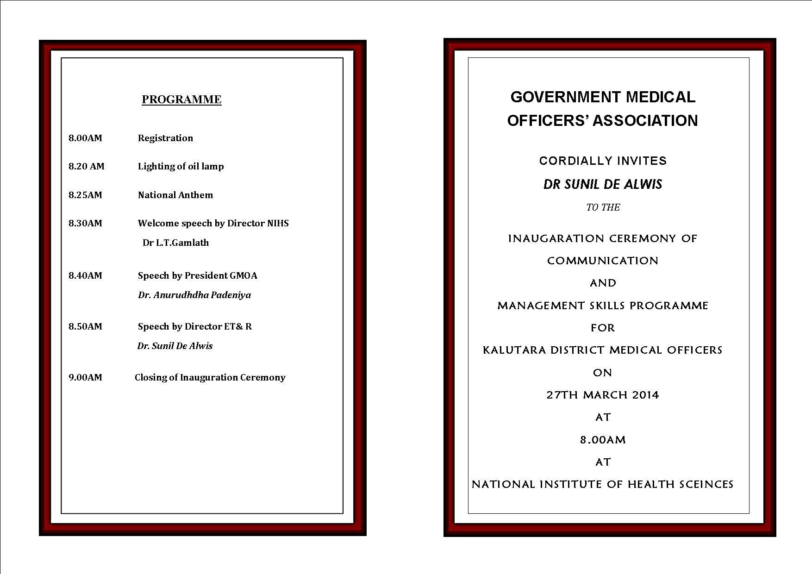
Invitation

Slide 15
Upto now
600 Medical officers underwent the
Communication and Management Skills Programme

Slide 16
THE WAY FORWARD
To organize 2 day Communication and Management skills programmes in other districts
To form a Safety council for medical officers
To produce GOOD QUALITY DOCTORS in the future.

Slide 17
If you are Interested
Send a fax or letter to GMOA requesting the communication skills programme
Contact Dr Mekhala Fernando (Executive Administrator for Communication and Management skills Programme) for further details

Slide 18
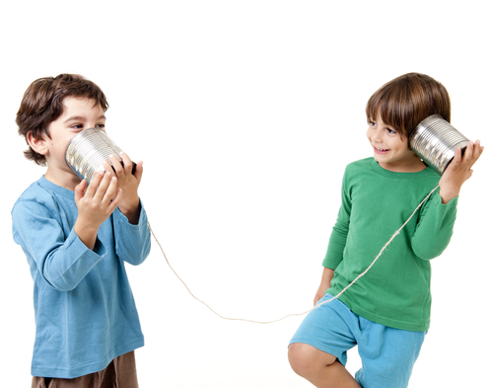
THANK YOU

